Slide 1


Software Development Skills Bootcamp
Python - 1
Copyright © e-Careers. All Rights Reserved

Slide 2


Python
Python is a high-level, general-purpose, interpreted programming language.
1) High-level
Python is a high-level programming language that makes it easy to learn. Python doesn’t require you to understand the details of the computer in order to develop programs efficiently.
2) General-purpose
Python is a general-purpose language. It means that you can use Python in various domains including:
Web applications
Big data applications
Testing
Automation
Data science, machine learning, and AI
Desktop software
Mobile apps
The targeted language like SQL which can be used for querying data from relational databases.

Slide 3
Python
3) Interpreted
Python is an interpreted language. To develop a Python program, you write Python code into a file called source code.
To execute the source code, you need to convert it to the machine language that the computer can understand. And the Python interpreter turns the source code, line by line, once at a time, into the machine code when the Python program executes.

Slide 4
Python
Python increases your productivity. Python allows you to solve complex problems in less time and fewer lines of code. It’s quick to make a prototype in Python.
Python becomes a solution in many areas across industries, from web applications to data science and machine learning.
Python is quite easy to learn in comparison with other programming languages. Python syntax is clear and beautiful.
Python has a large ecosystem that includes lots of libraries and frameworks.
Python is cross-platform. Python programs can run on Windows, Linux, and macOS.
Python has a huge community. Whenever you get stuck, you can get help from an active community.
Python developers are in high demand.

Slide 5
Python Syntax
If you’ve been working in other programming languages such as Java, C#, or C/C++, you know that these languages use semicolons (;) to separate the statements.
Python, however, uses whitespace and indentation to construct the code structure.
The following shows a snippet of Python code:
# define main function to print out something
def main():
i = 1
max = 10
while (i < max):
print(i)
i = i + 1
# call function main
main()

Slide 6
Python Syntax
By using indentation and whitespace to organize the code, Python code gains the following advantages:
First, you’ll never miss the beginning or ending code of a block like in other programming languages such as Java or C#.
Second, the coding style is essentially uniform. If you have to maintain another developer’s code, that code looks the same as yours.
Third, the code is more readable and clear in comparison with other programming languages.

Slide 7
Python Data Types
following are the standard or built-in data types in Python:
Numeric
Sequence Type
Boolean
Set
Dictionary
Binary Types

Slide 8
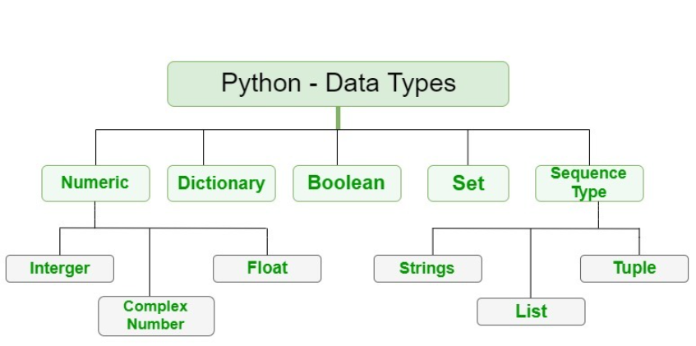
Python Data Types

Slide 9
Python variables
Python Variables
Python variables are simply containers for storing data values. Unlike other languages, such as Java, Python has no command for declaring a variable, so you create one the moment you first assign a value to it.
A Python variable may be assigned a value of one type and then later re-assigned a value of a different type. For example, x = "apples" can later be x = 5.

Slide 10
Basic Input/Output in Python
To get an input from users, you use the input() function
value = input('Enter a value:')
print(value)
The input function returns a string
int() function convers string into int
float(str) – convert a string to a floating-point number.
bool(val) – convert a value to a boolean value, either True or False.
str(val) – return the string representation of a value.

Slide 11
Getting type of value
>>> type(100)
<class 'int'>
>>> type(2.0)
<class 'float'>
>>> type('Hello')
<class 'str'>
>>> type(True)
<class 'bool'>

Slide 12
Output Operation in Python
The full syntax of the print() function is:
print(object= separator= end= file= flush=)
where,
object – values that will be printed. This is a compulsory field.
separator – allows us to separate multiple objects inside print().
end – allows us to add specific values like new line “\n”, tab “\t”.
file – where the values are printed.
flush – boolean specifying if the output is flushed or buffered. The default value is False.

Slide 13

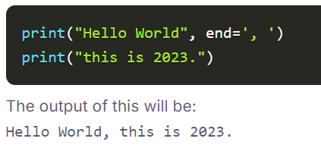
Python print statement
Example:
Basic Print Statement:
Print Statement using end parameter:

Slide 14
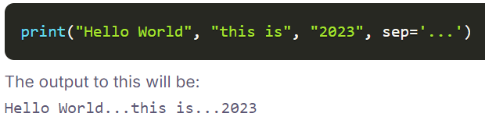
Output in Python
Example:
Print Statement using separator:

Slide 15
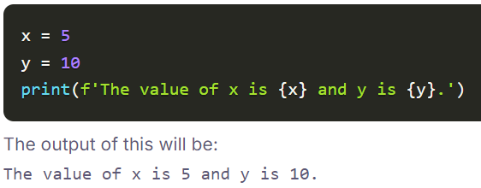
Output in Python
Print Statement using Format String:

Slide 16
Thank you

